Slide 1
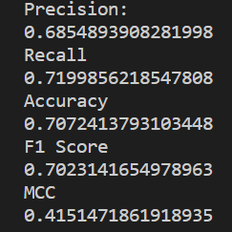
ID3 Decision Tree
Attributes Class
Attribute
gain
entropy
total
numberOfYes
yesTable
noTable
totalExposed
totalBuried
isLeaf
value
Methods
build_tree(node, table, availableAttributes)
get_results(x, node)
Presentation: Kareith Dyce
Code: Xavier Verdad
Report: James An
Attributes
1: "Proline",
2: "Hydrophobic",
3: "Polar",
4: "Positive",
5: "Negative",
6: "Charged",
7: "Small",
8: "Tiny",
9: "Aromatic",
10: "Aliphatic"
Precision – ratio between correctly predicted positives and positive observation
Recall – ratio between correct results and number of results returned
Accuracy – ratio between the correct predictions and total values returned
F1 Score – Weighted Average of precision and recall
MCC (Matthews Correlation Coefficient) - value between -1 and 1 where 1 is completely
correct and -1 is completely wrong

